Slide 1
Introduction to Machine Learning
Nicholas Mattei, Tulane University
CMPS3660 – Introduction to Data Science – Fall 2019
https://rebrand.ly/TUDataScience
Thanks to Bart Selman [Cornell] and
Zico Kolter [CMU]
Many Thanks
Slides based off Introduction to Data Science from John P. Dickerson - https://cmsc320.github.io/

Slide 2
Announcements
Schedule Update
Kaggle Data Science Challenge
Milestone 2 Tonight!
Lab 10 + 11 Up
More Machine Learning!
https://xkcd.com/1838/

Slide 3
The Data LifeCycle
Data Collection
Data Processing
Exploratory Analysis
&
Data Visualization
Analysis, Hypothesis Testing,
& ML
Insight
&
Policy Decision
Today

Slide 4
Wait, What is AI? What is ML?
Alan Turing 1950, “I propose to consider the question, ’Can machines think?’ … I shall replace the question by another, which is closely related to it and is expressed in relatively unambiguous words.”
The Imitation Game: “… a man (A), a woman (B) and an interrogator (C) … The object of the game for the interrogator is to determine which of the other two is the man and which is the woman.
John McCarthy et al. 1955, “… every aspect of learning or any other feature of intelligence can in principle be so precisely described that a machine can be made to simulate it.”
Tessler’s Theorem: “Intelligence is what machines haven’t done yet.”
I.e., ”If machines can do it, it isn’t intelligence.

Slide 5

AI for AI Researchers
Russell and Norvig, “’artificial intelligence’ is when a machine mimics ‘cognitive functions’ that humans associate with other human minds such as ‘learning’ and ‘problem solving’”
Broadly responsible for the agent based approach: “… rational agents that acts so as to achieve the best outcome, or, when there is uncertainty, the best expected outcome.”
Traditional Goals:
Reasoning, Planning, and Knowledge Representation;
Machine Learning and Natural Language Processing;
Perception (vision), and Embodiment (Robotics).
All of these are in service of (for some) creating Artificial General Intelligence (AGI).
Agent
Environment
Sensors
Actuators

Slide 6
Artificial General Intelligence?
What you think of when you think of AI most of the time.
Strong AI: program for the whole range of human cognition.
Weak AI: narrow or domain specific tasks.
If we can create a big enough system, we can simulate a human … or close enough.
Intelligence is just a function mapping inputs to outputs.
Is there a difference between faking it and making it?

Slide 7
Machine Learning
(Depending on whom you ask, either is AI or is a subfield of AI.)
Arthur Samuel 1959, “… give[s] computers the ability to learn without being explicitly programmed.”
Tom M. Mitchell, “A computer program is said to:
learn from experience E
with respect to some class of tasks T and
performance measure P if
its performance at tasks in T as measured by P, improves with experience E.”

Slide 8


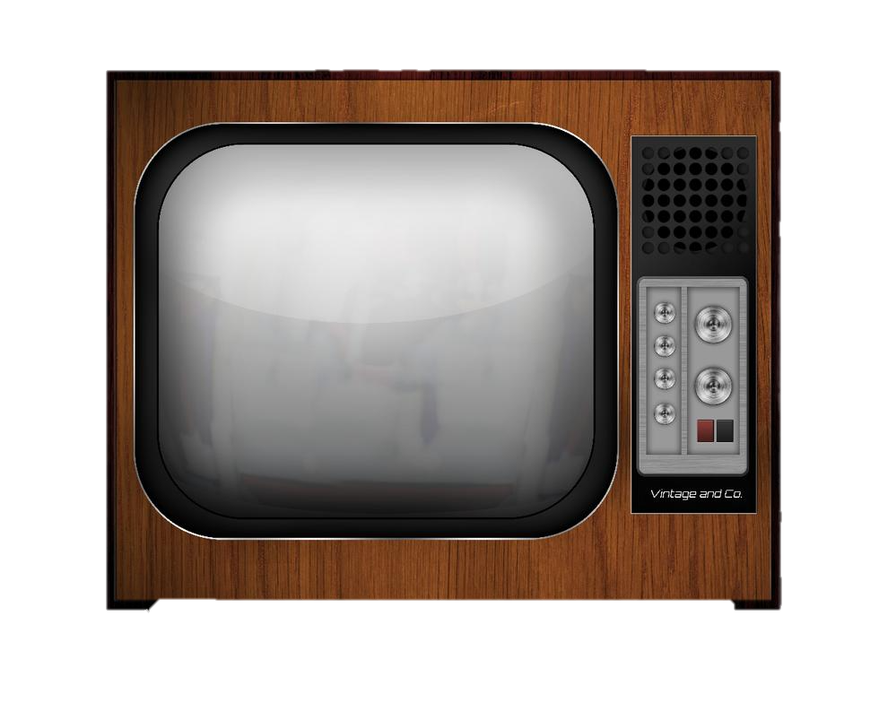



A Concrete Example: Supervised Learning
In many domains it’s hard to build a predictive model but easy to collect data!
Machine learning gives us a way to automatically infer a predictive model from the data.
Given many many many examples consisting of a vector of features (x) and their output label (y): ( [x₁, x₂, … x_{n}]⁽¹⁾, (y⁽¹⁾) ).
Training Data
( [x₁, x₂, … x_{n}]⁽¹⁾, (y⁽¹⁾) )
( [x₁, x₂, … x_{n}]⁽²⁾, (y⁽²⁾) )
( [x₁, x₂, … x_{n}]⁽³⁾, (y⁽³⁾) )
…
Machine Learning
Algorithm
Hypothesis Function
y^{(i)} ≈ h(x^{(i)})
Prediction
(Model)
New example x…
ŷ = h(x)

Slide 9
Learning: Types of Feedback
Supervised Learning.
Learn a function from examples of its inputs and outputs.
E.g., An agent is presented with many camera images and is told to learn which ones contain busses.
Agent learns to map from images to Boolean output 0/1 of bus not present/present.
Learning decision trees is a form of supervised learning.
Unsupervised Learning.
Learn patterns in the input with no output values supplied.
E.g,: Identify communities on the Internet.
Reinforcement Learning.
Learn from reinforcement (occasional rewards).
E.g., An agent learns how to play backgammon or go or chess against itself.

Slide 10
More

Slide 12
Learning: Mitchell’s Definition
A computer program is said to learn from:
experience E with respect to some class of
tasks T and
performance measure P
If its performance at tasks in T, as measured by P, improves with experience E.
We’re going to focus on a specific of learning:
Learning from Examples: Special case of inductive learning

Slide 13
Examples
Spam Filtering:
T: Classify Emails (HAM/SPAM)
E: Examples (e1, HAM), (e2, SPAM), (e3, HAM), (e4, SPAM)…
P: Prob. of mis-classification on new emails.
Personalized Retrieval
T: Find Documents the user wants for query.
E: Watch documents people click on (query/click pairs).
P: Number of Relevant Docs in Top-10
Play Checkers:
T: Play Checkers
E: Games against self
P: Winning Percentage.

Slide 15
Inductive Learning / Concept Learning
Task:
Learn (to imitate) a function f: X -> Y
Training Examples:
Learning algorithm is given the correct value of the function for particular inputs.
An example is a pair ( [x₁, x₂, … x_{n}]⁽¹⁾, (y⁽¹⁾) ) where x is the input vector of features and y is the output of the function f applied to x.
Goal:
Learn a function h: X -> Y that approximates f: X -> Y as well as possible.
Training Data
( [x₁, x₂, … x_{n}]⁽¹⁾, (y⁽¹⁾) )
( [x₁, x₂, … x_{n}]⁽²⁾, (y⁽²⁾) )
( [x₁, x₂, … x_{n}]⁽³⁾, (y⁽³⁾) )
…
Machine Learning
Algorithm
Hypothesis Function
y^{(i)} ≈ h(x^{(i)})
Prediction
(Model)
New example x…
ŷ = h(x)

Slide 16
Classification v. Regression
Naming:
If Y is a discrete set, then we call it Classification.
If Y is not a discrete set, then we call it Regression.
Examples:
Steering a vehicle…
road images -> direction to turn wheel (distance).
Medical Diagnosis…
patient symptoms -> has/does not have disease.
Forensic Hair Comparison…
Image of two haris -> match or not.
Stock Market Prediction:
closing price of last few days -> market will go up or down (how much?)
Noun Phrase Coreference:
description of two things in document -> same entity?

Slide 45
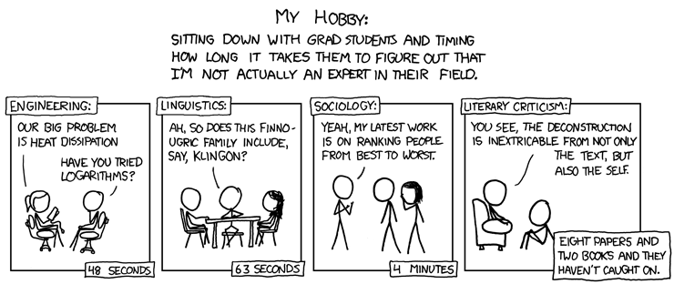
Announcements
Course Evals Open
Reminder: Laptop Policy
Questions 9 Review
Short NLP Lecture
Lab 10!
https://xkcd.com/451/

Slide 49
Semantics: Text Classification
Is it spam?
Who wrote this paper? (Author identification)
https://en.wikipedia.org/wiki/The_Federalist_Papers#Authorship
https://www.uwgb.edu/dutchs/pseudosc/hidncode.htm
¡Identificación del idioma!
Sentiment analysis
What type of document is this?
When was this document written?
Readability assessment

Slide 50
Text Classification
Input:
A document w
A set of classes Y = {y₁, y₂, …, y_{J}}
Output:
A predicted class y ∈ Y
(We’ll do more classification in our bonus lab!)

Slide 51
Text Classification
Hand-coded rules based on combinations of terms (and possibly other context)
If email w:
Sent from a DNSBL (DNS blacklist) OR
Contains “Nigerian prince” OR
Contains URL with Unicode OR …
Then: y_{w} = spam
Pros: ?????????
Domain expertise, human-understandable
Cons: ?????????
Brittle, expensive to maintain, overly conservative

Slide 52
Text Classification
Input:
A document w
A set of classes Y = {y₁, y₂, …, y_{J}}
A training set of m hand-labeled documents {(w₁, y₁), (w₂, y₂), …, (w_{m}, y_{m})}
Output:
A learned classifier w → y
This is an example of ????????

Slide 53
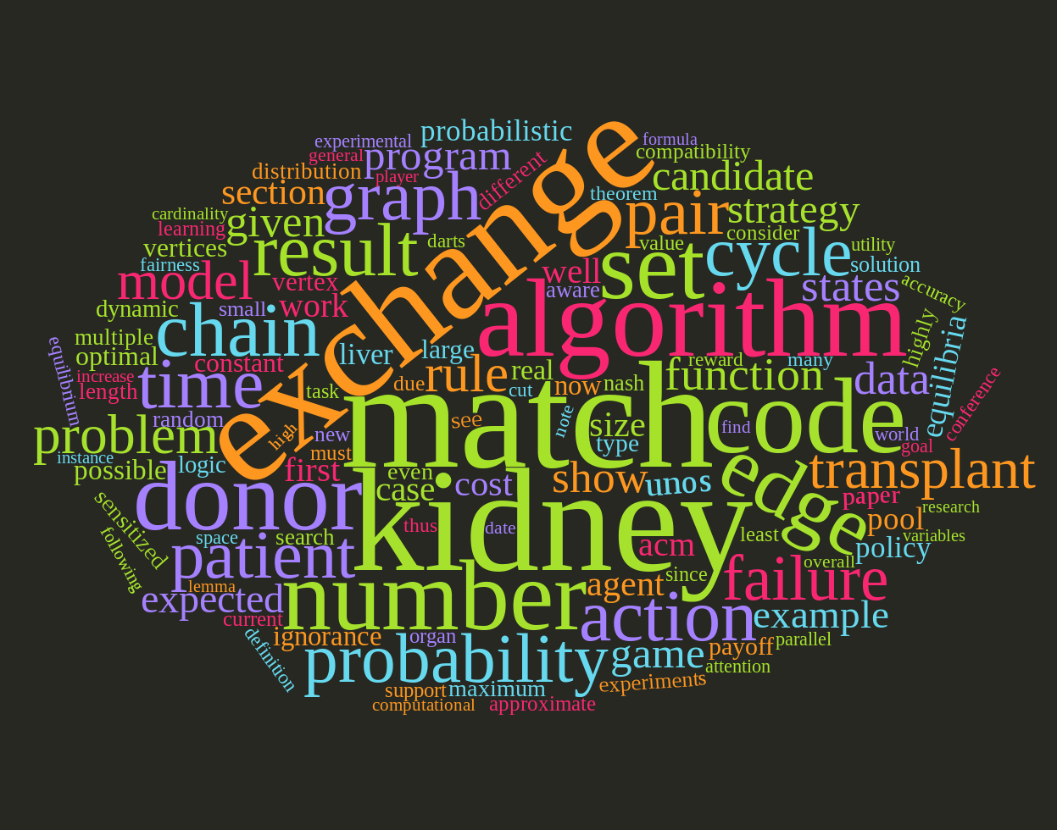
Representing a document “in math”
Simplest method: bag of words
Represent each document as a vector of word frequencies
Order of words does not matter, just #occurrences

Slide 54
Bag of Words Example
the quick brown fox jumps over the lazy dog
I am he as you are he as you are me
he said the CMPS3660 is more CMPSs than the CMPS3140
the | CMPS3660 | you | he | I | quick | dog | me | CMPSs | … | than
2 | 0 | 0 | 0 | 0 | 1 | 1 | 0 | 0 | … | 0
0 | 0 | 2 | 2 | 1 | 0 | 0 | 1 | 0 |  | 0
2 | 1 | 0 | 1 | 0 | 0 | 0 | 0 | 1 |  | 1
Document 1
Document 2
Document 3

Slide 55
Term Frequency
Term Frequency: the number of times a term appears in a specific document
tf_{ij} = frequency of word j in document i
This can be the raw count (like in the bag of words (BOW) in the last slide):
tf_{ij} ∈ {0,1} if word j appears or doesn’t appear in doc I
log(1 + tf_{ij}) – reduce the effect of outliers
tf_{ij} / max_{j} tf_{ij} – normalize by document i’s most frequent word
What can we do with this?
Use as features to learn a classifier w → y …!

Slide 56
Defining Features From Term Frequency
Classifying if a document was written by The Beatles or not (i.e., binary classification):
Two classes y ∈ Y = { 0, 1 } = { not_beatles, beatles }
Let’s use tf_{ij} ∈ {0,1}, which gives:
Then represent documents with a feature function: f(x, y = not_beatles = 0) = [x^{T}, 0^{T}, 1]^{T} f(x, y = beatles = 1) = [0^{T}, x^{T}, 1]^{T}
the | CMSC320 | you | he | I | quick | dog | me | CMSCs | … | than
1 | 0 | 0 | 0 | 0 | 1 | 1 | 0 | 0 | … | 0
0 | 0 | 1 | 1 | 1 | 0 | 0 | 1 | 0 |  | 0
1 | 1 | 0 | 1 | 0 | 0 | 0 | 0 | 1 |  | 1
x₁^{T} =
y₁ = 0
x₂^{T} =
y₂ = 1
x₃^{T} =
y₃ = 0

Slide 57
Linear Classification
We can then define weights θ for each feature
θ = { <CMPS3660, not_beatles> = +1, <CMPS3660, beatles> = -1, <walrus, not_beatles> = -0.3, <walrus, beatles> = +1, <the, not_beatles> = 0, <the, beatles>, 0, … }
Write weights as vector that aligns with feature mapping
Score 𝝍 of an instance x and class y is the sum of the weights for the features in that class:
𝝍_{xy} = Σ θ_{n} f_{n}(x, y)
= θ^{T} f(x, y)

Slide 58
Linear Classification
We have a feature function f(x, y) and a score 𝝍_{xy} = θ^{T} f(x, y)
And return the class with highest score!
Compute the score of the document for that class
For each class y ∈ { not_beatles, beatles }
Where did these weights come from? We’ll talk about this in the ML lectures …
(… and also this whole “linear classifier” thing.)

Slide 59
Explicit Example
We are interested in classifying documents into one of two classes y ∈ Y = { 0, 1 } = { hates_cats, likes_cats}
Document 1: I like cats
Document 2: I hate cats
Now, represent documents with a feature function: f(x, y = hates_cats = 0) = [x^{T}, 0^{T}, 1]^{T} f(x, y = likes_cats = 1) = [0^{T}, x^{T}, 1]^{T}
I | like | hate | cats
1 | 1 | 0 | 1
1 | 0 | 1 | 1
x₁^{T} =
y₁ = ?
x₂^{T} =
y₂ = ?

Slide 60
Explicit Example
I | like | hate | cats
1 | 1 | 0 | 1
1 | 0 | 1 | 1
f(x, y = 0) = [x^{T}, 0^{T}, 1]^{T} f(x, y = 1) = [0^{T}, x^{T}, 1]^{T}
x₁^{T} =
y₁ = ?
x₂^{T} =
y₂ = ?
y=0: hates_cats
y=1: likes_cats
(1)
I | like | hate | cats | I | like | hate | cats | --
1 | 1 | 0 | 1 | 0 | 0 | 0 | 0 | 1
0 | 0 | 0 | 0 | 1 | 1 | 0 | 1 | 1
1 | 0 | 1 | 1 | 0 | 0 | 0 | 0 | 1
0 | 0 | 0 | 0 | 1 | 0 | 1 | 1 | 1
f(x₁, y = hates_cats = 0) =
f(x₁, y = likes_cats = 1) =
f(x₂, y = hates_cats = 0) =
f(x₂, y = likes_cats = 1) =

Slide 61
Explicit Example
Now, assume we have weights θ for each feature
θ = { <I, hates_cats> = 0, <I, likes_cats> = 0,
<like, hates_cats> = -1, <like, likes_cats> = +1,
<hate, hates_cats> = +1, <hate, likes_cats> = -1,
<cats, hates_cats> = -0.1, <cats, likes_cats = +0.5> }
Write weights as vector that aligns with feature mapping:
y=0: hates_cats
y=1: likes_cats
(1)
Parameter vector θ ^{T} =
0 | -1 | 1 | -0.1 | 0 | 1 | -1 | 0.5 | 1
I | like | hate | cats | I | like | hate | cats | --
1 | 1 | 0 | 1 | 0 | 0 | 0 | 0 | 1
0 | 0 | 0 | 0 | 1 | 1 | 0 | 1 | 1
1 | 0 | 1 | 1 | 0 | 0 | 0 | 0 | 1
0 | 0 | 0 | 0 | 1 | 0 | 1 | 1 | 1
f(x₁, y = hates_cats = 0) =
f(x₁, y = likes_cats = 1) =
f(x₂, y = hates_cats = 0) =
f(x₂, y = likes_cats = 1) =

Slide 62
Explicit Example
Score 𝝍 of an instance x and class y is the sum of the weights for the features in that class:
𝝍_{xy} = Σ θ_{n} f_{n}(x, y)
= θ^{T} f(x, y)
Let’s compute 𝝍_{x1,y=hates_cats} …
𝝍_{x1,y=hates_cats} = θ^{T} f(x₁, y = hates_cats = 0)
= 0*1 + -1*1 + 1*0 + -0.1*1 + 0*0 + 1*0 + -1*0 + 0.5*0 + 1*1
= -1 - 0.1 + 1 = -0.1
1 | I
1 | like
0 | hate
1 | cats
0 | I
0 | like
0 | hate
0 | cats
1 | –
hates_cats
likes_cats
θ ^{T} =
0 | -1 | 1 | -0.1 | 0 | 1 | -1 | 0.5 | 1
(1)
f(x₁, y = 0)

Slide 63
Explicit Example
Saving the boring stuff:
𝝍_{x1,y=hates_cats} = -0.1; 𝝍_{x1,y=likes_cats} = +2.5
𝝍_{x2,y=hates_cats} = +1.9; 𝝍_{x2,y=likes_cats} = +0.5
We want to predict the class of each document:
Document 1: argmax{ 𝝍_{x1,y=hates_cats}, 𝝍_{x1,y=likes_cats} } ????????
Document 2: argmax{ 𝝍_{x2,y=hates_cats}, 𝝍_{x2,y=likes_cats} } ????????
Document 1: I like cats
Document 2: I hate cats

Slide 64
Inverse Document Frequency
Recall:
tf_{ij} = frequency of word j in document i
Any issues with this ??????????
Term frequency gets overloaded by common words
Inverse Document Frequency (IDF): weight individual words negatively by how frequently they appear in the corpus:
IDF is just defined for a word j, not word/document pair j, i

Slide 65
Inverse Document Frequency
the | CMSC320 | you | he | I | quick | dog | me | CMSCs | … | than
2 | 0 | 0 | 0 | 0 | 1 | 1 | 0 | 0 | … | 0
0 | 0 | 2 | 2 | 1 | 0 | 0 | 1 | 0 |  | 0
2 | 1 | 0 | 1 | 0 | 0 | 0 | 0 | 1 |  | 1
Document 1
Document 2
Document 3

Slide 66
TF-IDF
How do we use the IDF weights?
Term frequency inverse document frequency (TF-IDF):
TF-IDF score: tf_{ij} x idf_{j}
This ends up working better than raw scores for classification and for computing similarity between documents.
the | CMSC320 | you | he | I | quick | dog | me | CMSCs | … | than
0.8 | 0 | 0 | 0 | 0 | 1.1 | 1.1 | 0 | 0 | … | 0
0 | 0 | 2.2 | 0.8 | 1.1 | 0 | 0 | 1.1 | 0 |  | 0
0.8 | 1.1 | 0 | 0.4 | 0 | 0 | 0 | 0 | 1.1 |  | 1.1
Document 1
Document 2
Document 3

